Slide 1
Topic Modeling Airbnb Reviews
Tushar Deswal
Preeyank Pable

Slide 2

AGENDA
Business Objective
How to achieve?
Data Dictionary
Pre-processing the data
Create Document word matrix
Topic Modeling
Selecting the best model
How the model will help the business

Slide 3
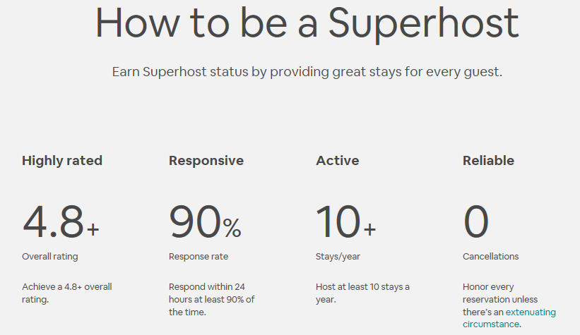

BUSINESS OBJECTIVE – CURRENT SITUATION
AirBnb currently uses many parameters to upgrade a host to a super-host:
Host listings
Reviews/month
Review ratings
Cancellations
Still there is discontent among many hosts – many feel they should be upgraded to Super-hosts

Slide 4
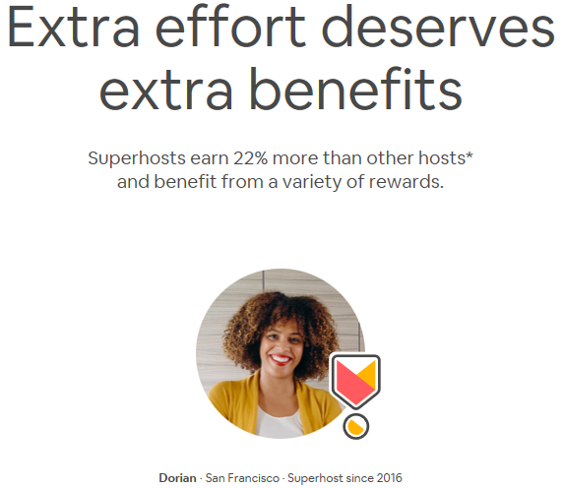
BUSINESS OBJECTIVE – BENEFITS OF BECOMING A SUPERHOST
Priority placement
Profile badge
Additional 20% referral bonus
Priority support
Special discounts from Tax partners

Slide 5
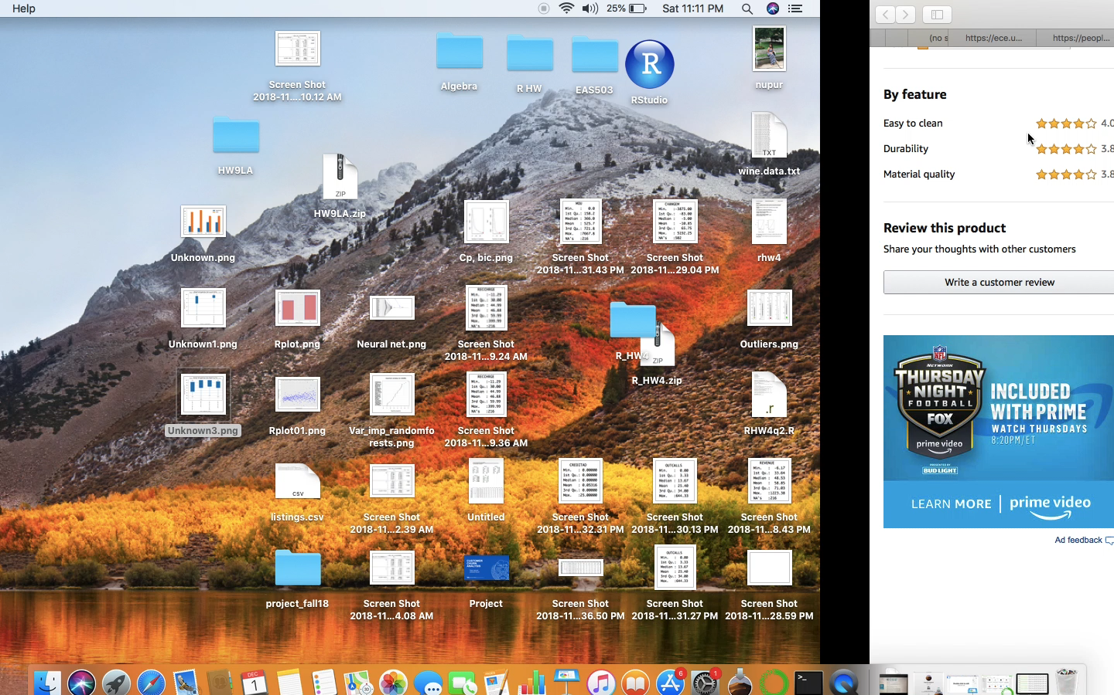
BUSINESS OBJECTIVE – TOPIC MODELING IN ACTION @AMAZON

Slide 6
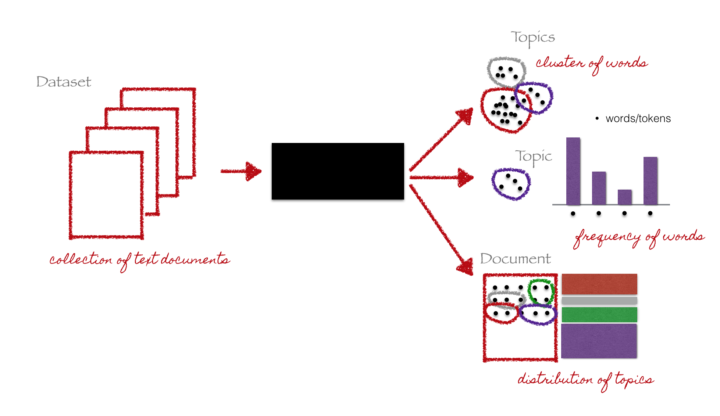
INTRODUCTION TO TOPIC MODELING – USING USER REVIEWS EFFICIENTLY
The Problem with Information: as more information becomes available, it is harder and harder to find what we are looking for
A Solution: Use topic models to discover hidden topic- based patterns. There are many techniques to perform topic modeling, we have used LDA (Latent dirichlet allocation)
TION

Slide 7
Latent Dirichlet allocation
LDA or latent Dirichlet allocation is a “generative probabilistic model” of a collection of composites made up of parts. In terms of topic modeling, the composites are documents and the parts are words and/or phrases (n-grams).
We have used Perplexity and Log-likelihood to come up with optimal number of Topics

Slide 8
DATA DICTIONARY
We have used two tables for creating the Final Reviews table
We have selected review data only for Boston listings and a subset of reviews so that Total review < 25000
Listings
Description
Reviews
Costing
Amenities
Location information
Host information
Neighborhood
Comments
Property id.
Reviewer id
Property id

Slide 9
TEXT PRE-PROCESSING
Tokenization
Tokenization is the process of breaking a stream of text into tokens
Lemmatization
Removes inflectional endings only and returns the base form of word known as lemma
Stop-words removal
Removal of commonly occurring words. – a, an, and, as, for, in, of..

Slide 10



DATA PRE-PROCESSING
Review in the raw form
After tokenizing lowercasing and removing punctuation
After lemmatization

Slide 11
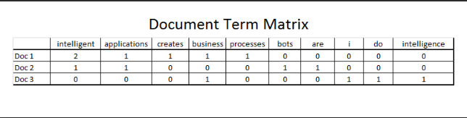
DOCUMENT WORD MATRIX
A document-term matrix or term-document matrix is a mathematical matrix that describes the frequency of terms that occur in a collection of documents.
The sparsity of the matrix = 0.71%NT WORD MATRIX

Slide 12
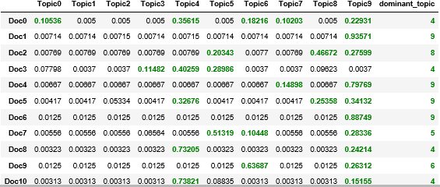
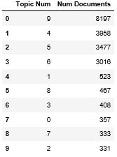
BUILDING LDA MODEL
We select the optimum number of topics using the GridsearchCV function
It returns a model with the lowest perplexity and the highest Log-likelihood score
We also get the Document-Topic matrix which helps to interpret the loading of each topic in individual documents
Document Topic Matrix
Topics distribution across documents

Slide 13
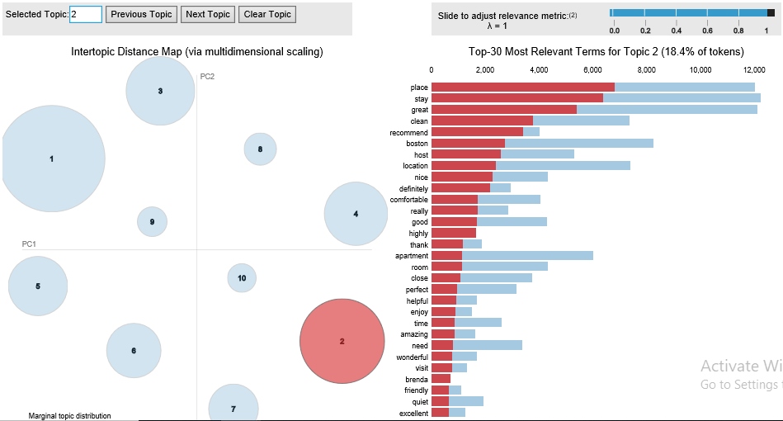
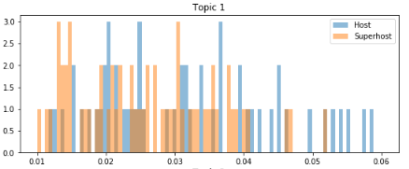
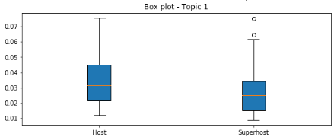
INTERPRETING THE TOPICS
We will use PyLDAvis package to visualize each topic and the top significant words in each topic
Below is the word distribution for Topic 2 – Awesome experience
Topic 2 Histogram
Topic 2 Box plot

Slide 14
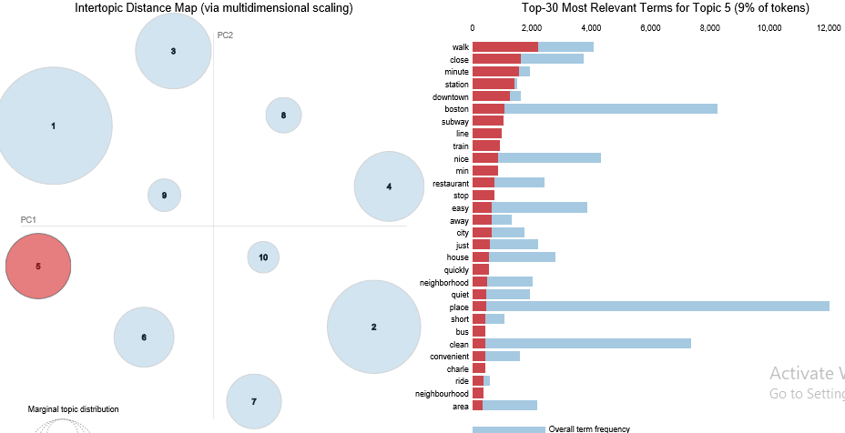
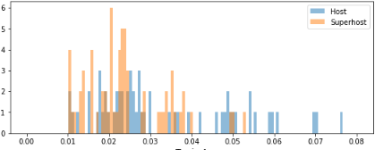
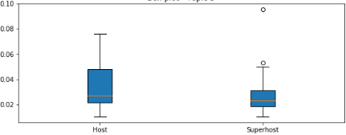
INTERPRETING THE TOPICS
Word distribution – Topic 5 - Commute/travel
Topic 5 Histogram
Topic 5 Box plot

Slide 15
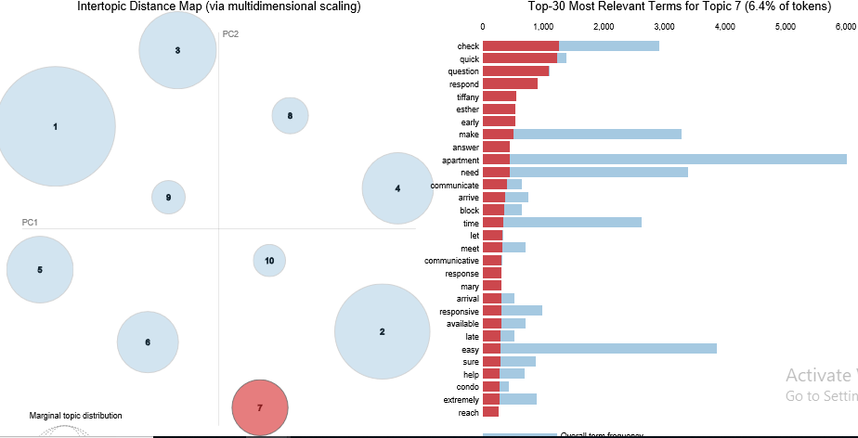
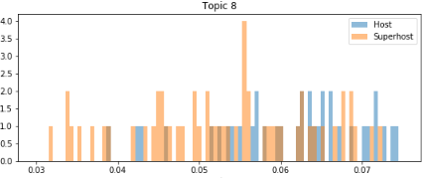
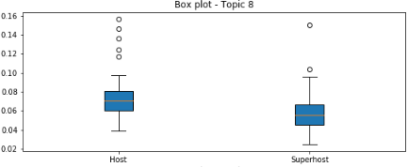
INTERPRETING THE TOPICS
Word distribution – Topic 7 Communicative host
Topic 7 Histogram
Topic 7 Box plot

Slide 16


